Slide 1
Operation Management
Dr. Hemantkumar P. Bulsara
[B.Engg.(Production), MBA (Marketing, CIS & International Business), FDPM – IIM A, PhD (Management)]
Associate Professor – Management
Former Head
Applied Mathematics and Humanities Department
S V National Institute of Technology
Surat - India

Slide 2
Introduction
The management of the conversion processes which transforms inputs such as raw material, labour etc. into outputs in the form of finished goods and services is termed as Operations Management (OM).
OM is the business function that is responsible for managing and coordinating the resources required to produce a company’s products and services.
The role of OM is to transform organizational inputs into company’s products or services outputs. OM is responsible for a wide range of decisions, ranging from strategic to tactical.

Slide 3
System concept
A system is an arrangement of components designed to achieve a particular objective (or objectives) according to plan.
The components may be either physical or conceptual or both, but they all share a unique relationship with each other and with the overall objective of the system.
A systems approach to operations management problems places strong emphasis upon the integrative nature of management responsibilities, recognizing both the interdependence and the hierarchical nature of subsystems.

Slide 4
Random
Fluctuation
Input
Monitoring
Conversion
Process
Output
feedback

Slide 5
Inputs | Transformation | Outputs
Energy, Raw vegetables | Cleaning | Clean vegetables
Energy, Metal sheets | Cutting/Rolling/Welding | Cans
Energy, Vegetables | Cutting/Chopping | Cut vegetables
Energy, Water, Vegetables | Cooking | Boiled vegetables
Energy, Cans, Boiled vegetables | Placing | Can food

Slide 6
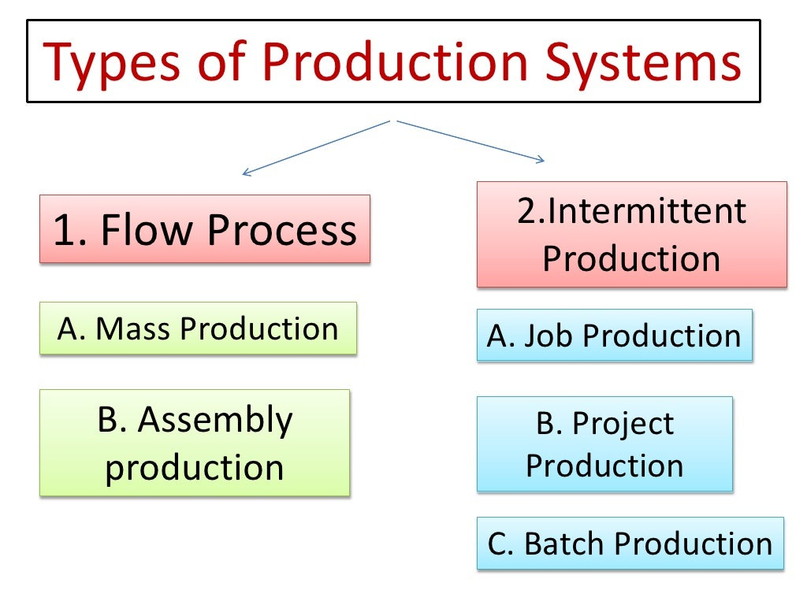
Types of production systems
Mass production( Continuous and Assembly line)
Batch production
Job shop

Slide 7
Plant location
Plant location means the establishment of an industry at a particular place.
The location of the plant can have a critical influence on the profitability of a project, and the scope for future expansion.
It is challenging to set down rules whereby the problem of facilities location can be programmed but there are a number of factors which should be considered when selecting a suitable site.
The essential purpose of location investigation is to maximize the profits by minimizing the total cost of production linked with the production process.

Slide 8
Critical Success Factors of Location Decisions:
A. Country Decision
Political risks, government rules, attitudes, incentives
Cultural and economic issues
Location of markets
Labor talent, attitudes, productivity, costs
Availability of supplies, communications, energy
Exchange rates and currency risks
B. Region/ Community Decision
Attractiveness of region
Corporate desires
Costs and availability of utilities
Environmental regulations
Government incentives and fiscal policies
Labor availability, costs, attitudes towards unions
Land/construction costs
Proximity to raw materials and customers
C. Site Decision
Site size and cost
Air, rail, highway, and waterway systems
Zoning restrictions
Proximity of services/ supplies needed
Environmental impact issues

Slide 9
Plant location strategy
Minimum handling of material
Minimum damage and spoilage of materials
Reduced congestion of materials, machinery and man
Flexibility with regards to changing production conditions

Slide 10
Plant layout
It is the physical preparation of equipment and facilities within a plant. Optimizing the layout of a plant can improve productivity, safety and quality of products. The basic objective is to ensure a smooth flow of work, material, people and information. It must facilitate the production process, minimize material handling time and cost.
A perfect plant layout must emphasis on –
Minimizing the operational cost and maximizing the productivity of the manufacturing unit
Allow flexibility of operations
Ease of production flow
Economic use of the building
Promote effective utilization of manpower
Provide for employees’ convenience
Safety & comfort at work and maximum exposure to natural light

Slide 11
Basic objectives of plant layout
A plant layout must achieve the following objectives:
Enhance productivity
Maximize production capacity
Avoid delays in production activities
Efficient utilization of available floor space
Minimize material handling costs
Enhance labour efficiency
Improve employee morale
Ensure ease of supervision & control
Allow optimum utilization of machinery & equipment
Provide for flexibility in production volume
Help easy maintenance
Support employee health & safety
Minimize hazards to employees
Mitigate accident risks

Slide 12
Inputs to the Plant layout decision
Specification of objectives of the system in terms of output and flexibility
Estimation of product or service demand on the system
Processing requirements in terms of number of operations and amount of flow between departments and work centres
Space requirements for the elements in the layout
Space availability within the facility itself

Slide 13
Advantages of a good layout:
The overall process time and cost will be minimized by reducing unnecessary handling and movement.
Supervision and control will be simplified by the elimination of ‘hidden corners’
Changes in the programmers will be most readily accommodated.
Total output from a given facility will be as high as possible by making the maximum effective use of available space and resources.
A feeling of unity among employees will be encouraged by avoiding unnecessary segregation.
Quality of the products or service will be sustained by safer and more effective methods of operation.

Slide 14
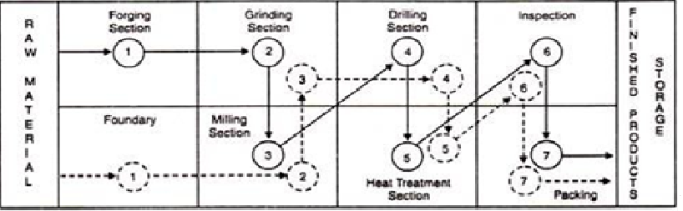
Types of Plant layout:
Process layout or Functional layout - Process layout is applicable where similar equipment, machinery & task tools are grouped together, also known as a functional layout useful for low volume & high variety production jobs.

Slide 15
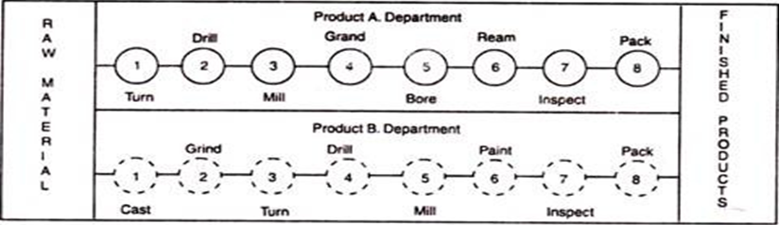
Product layout or Line layout - Product layouts are used to achieve a smooth and rapid flow of large volumes of products or customers through a system. They achieve a high degree of labour and equipment utilization.

Slide 16
Fixed position layout – In this layout the material / job remains in a fixed position, but machinery, tools, workmen etc. are brought to the material – Project layout.
Cellular layout – It is a type of layout in which machines are grouped into what is referred to as a cell. It provides faster processing time, less material handling, less work-in-process inventory, and reduced setup time.
Combination layout - Sometimes, every manufacturing unit requires a customized plant layout wherein a combination of plant layout types may be employed which is known as a combination layout. A company may opt to prepare a combination layout in order avail the benefits from one or more plant layout type.

Slide 17
Material handling
The primary objective of using a Material Handling System is to confirm that the material in the right amount is safely delivered to the chosen destination at the right time and at minimum cost.
The Material Handling System is properly designed not only to ensure the minimum cost and compatibility with other manufacturing equipment but also to meet safety concerns.
Material Handling simply means loading, moving and unloading of material.
Material Handling is defined by the Materials Handling Institute (MHI), as the movement, storage, control, and protection of materials and products throughout the process of their manufacture, distribution, consumption, and disposal.
The five commonly recognized aspects of Material Handling are motion, time, place, quantity, space.

Slide 18
Classification of Material Handling:
Holding, feeding, metering
Transferring, positioning
Lifting, hoisting, elevating
Dragging, pulling, pushing
Loading, carrying, excavating
Conveyor moving and handling
Automatic guided vehicle transporting
Robot manipulating
Identifying, sorting, controlling
Storing, warehousing
Order picking, packing
Loading, shipping

Slide 19
Importance of Materials Handling:
By ensuring the right quantity of materials delivered at the right place at the right time most economically, it improves efficiency of a production system.
Indirect labour cost is cut down.
During storage and movement reduces damage of materials.
Maximize space utilization by proper storage of materials and thereby reduce storage and handling cost.
Proper materials handling minimises accident.
By improving materials handling overall cost reduces.
Improve customer services by supplying materials in a manner convenient for handlings.
Increase efficiency and sale ability of plant and equipment with integral materials handling features.

Slide 20
Principles of Material Handlings:
Planning principle - A plan is a recommended sequence of action that is defined in advance of implementation. In its simplest form a material handing plan defines the material (what) and the moves (when and where); together they define the method (how and who).
Standardization principle - Standardization means less variety and customization in the methods and equipment employed.
Work principle - The measure of work is material handling flow (volume, weight or count per unit of time) multiplied by the distance moved.
Orientation principle - Study the system relationships carefully prior to initial planning in order to classify current approaches and problems, physical and economic constraints, and to establish future necessities and objectives.
Unit load principle - Handle product in as large a unit load as practical.

Slide 21
Ergonomic Principle - Recognize human capabilities and boundaries.
Space utilization principle - Space in material handling is three dimensional and therefore is counted as cubic space.
System flow principle - Integrate data flow with the physical material flow in handling and storage.
Automation Principle - All items expected to be handled automatically must have features that accommodate mechanized and automated handling.
Ecology principle - Minimize adverse effects on the environment when selecting MH equipment and procedures.
Life Cycle Cost Principle - Life cycle costs include all cash flows that will occur between the time the first rupee is spent to plan or procure a new piece of equipment, or to put in place a new method, until that method and/or equipment is totally replaced.

Slide 22
Factors to be Considered while Selecting a Material Handling Equipment:
Material to be moved
Plant buildings and layout
Type of production machines
Type of material flow pattern
Type of production
Cost of material handling equipment
Handling cost
Life of equipment
Amount of care and maintenance required for the material handling equipment

Slide 23
Equipment of Material Handling:
Industrial trucks include hand trucks such as two-wheeled, four-wheeled, hand lift, and forklift and powered trucks such as forklift, tractor-trailer trains, industrial crane trucks, and side loaders
Conveyors such as belt, chute, roller, wheel, slat, chain, bucket, trolley, tow, screw, vibrating, and pneumatic
Monorails, hoists, and cranes such as bridge, gantry, tower, and stacker
Automated guided vehicle systems such as unit load carriers, towing, pallet trucks, fork trucks, and assembly line
Automated storage and retrieval systems (AS/RS) such as unit load, mini-load, person-on-board, deep lane, and storage carousel systems

Slide 24
Inventory management
Meaning of Inventories:
Inventory consists of items which are finished and held in sales or are in the process of production or the items which are kept as raw material. a) Raw materials are those basic fabricated materials which are yet to go through any conversion. b) Finish parts which may either be bought-out-parts (produced by suppliers) or piece parts (made in own company). c) Work-in-process Inventories: these items are partially completed state. These items are can be found on the conveyers, trucks, pallets, in and around the machines and in store section waiting for assemble. d) Finish Goods are the products or goods which are ready to be shipped. e) Tools comprises standard and hand tools. f) Supplies are materials in running the plant or in making companies product but do not go into the product. g) Machinery spares include consumable spares and replacement spares

Slide 25
Major Reasons for Keeping the Inventories: a) To economies on buying or manufacturing cost b) To keep pace with changing market conditions c) To satisfy demand during period of replenishment d) To take care contingencies (i.e. prevent stock-outs) e) To stabilize production f) To prevent loss of sale g) To satisfy other business constraints
Objectives of Scientific Inventory Control System:
a) Continuity of productive operations b) Effective use of capital c) Reduction of administrative workload d) Service of customers e) Economy in purchasing f) Reduction of risk in loss g) Practical system h) Administrative simplicity

Slide 26
Classifications of Inventory :
ABC analysis: ABC analysis work on a very important principle “vital few : trivial many”. Statistical data reveals that only a few items account for the maximum annual expenditure on materials. These few items called ‘A’ items, therefore, hold the key to business. The other items, known as ‘B’ and ‘C’ items, are numerous in number but their contribution is less significant.
HML analysis: HML analysis is similar to ABC analysis except for the difference that instead of usage value, price criteria is used. The items under this are categorized into three types such as high, medium and low. The cut of lines of the items are fixed by the management.
VED analysis: VED analysis categorizes the items according to their criticality. The items are classified as vital, essential and desirable. Vital category includes those items, which are very essential to running the production. Essential group includes items which have high stock out costs. And desirable group comprises of items which do not cause any immediate loss of production.
SDE analysis: SDE analysis classifies the items in to three groups called scarce, difficult and easy. Scare group consist of items which are in short supply imported or canalized through government agencies. Difficult group consist of items which are available indigenously but are not easy procure. Easy group consist of items which are readily available.

Slide 27
G-NG-LF analysis/GOLF analysis: The analysis classifies items into four groups namely G-NG-L and F. G group covers items procured from Government suppliers such as the STC, the MMTC and the public sector undertakings. NG group comprises of items procured from non-government suppliers. L group consist items bought from “local suppliers”. F group contains items which are purchased from foreign suppliers.
S-OS analysis: S-OS analysis is based on seasonality of the items and it classifies the items into two groups S (seasonal) and OS (i.e. off seasonal). The analysis identifies items which are available only limited period, available through the year.
F-S-N analysis: F-S-N analysis is based on consumption figures of items. The items are classified in to three categories. F fast moving items, requires to be viewed regularly. S low moving items, these items having higher stock than their rate of consumption. N non-moving, the items which are not being consumed.
X-Y-Z analysis: X-Y-Z analysis is based on value of the stocks on hand. The items whose inventory values are high are called X items while those whose inventory values are low are called Z items. And Y items are those which have moderate inventory stocks.

Slide 28
Purchasing and store system
Purchasing:
Purchasing may be defined as that function of a business undertaking which is responsible for the procurement of materials, tools, implements, machinery and service required to produce certain goods and services.
Procurement:
Procurement means acquisition of materials by any method whatsoever and is a part of Material Management.
Objectives of Purchasing Department:
To procure right material
To procure material in right quantities
To procure materials in right quality
To procure material from right and reliable source or vendor
To procure material economically, i.e. at right or reasonable price
To receive and deliver materials at right place and at right time

Slide 29
Principles of Scientific Purchasing:
There are six R’s wise or scientific purchasing. These are
Right Quality
Right Quantity
Right Price
Right Time of Delivery
Right Price of Delivery
Right Source of Supply

Slide 30
Methods of Purchasing:
a) Purchasing by requirement-undertaking Purchase only when necessary b) Purchasing for specified future period- goods regularly used by the organizations but in small quantity c) Purchasing from the favourable market- using the correct forecast of market conditions d) Speculative purchasing- Purchase is made in speculation of rise in prices e) Contract purchasing- Buying goods under forward buying contracts f) Purchasing small items in group- Purchase various items in small quantities g) Scheduled purchasing- estimate of purchasing being made in the future in accordance with production schedules for future period

Slide 31
Standard Purchase Procedure for a Large Scale Organization:
a) Recognition of the need b) Selection of source of supply c) Inviting quotations d) Processing the quotations e) Placing the order and follow up f) Receipt and inspection g) Approval of Payment

Slide 32
Thank You
Dr. Hemantkumar P. Bulsara
[B.Engg.(Production), MBA (Marketing, CIS & International Business), FDPM – IIM A, PhD (Management)]
Associate Professor – Management
Former Head
Applied Mathematics and Humanities Department
S V National Institute of Technology
Surat - India

